Slide 1
UNIT-4 Neo4j

Slide 2
Neo4j is the world's leading open source Graph Database which is developed using Java technology. It is highly scalable and schema free (NoSQL).
What is a Graph Database?
A graph is a pictorial representation of a set of objects where some pairs of objects are connected by links. It is composed of two elements - nodes (vertices) and relationships (edges).
Graph database is a database used to model the data in the form of graph. In here, the nodes of a graph depict the entities while the relationships depict the association of these nodes.

Slide 3
Why Graph Databases?
Nowadays, most of the data exists in the form of the relationship between different objects and more often, the relationship between the data is more valuable than the data itself.
Relational databases store highly structured data which have several records storing the same type of data so they can be used to store structured data and, they do not store the relationships between the data.
Unlike other databases, graph databases store relationships and connections as first-class entities.
The data model for graph databases is simpler compared to other databases and, they can be used with OLTP systems. They provide features like transactional integrity and operational availability.

Slide 4
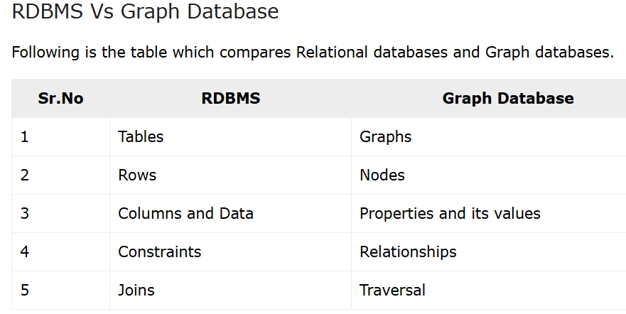

Slide 5
Advantages of Neo4J
Flexible data model − Neo4j provides a flexible simple and yet powerful data model, which can be easily changed according to the applications and industries.
Real-time insights − Neo4j provides results based on real-time data.
High availability − Neo4j is highly available for large enterprise real-time applications with transactional guarantees.
Connected and semi structures data − Using Neo4j, you can easily represent connected and semi-structured data.

Slide 6
Advantages of Neo4J
Easy retrieval − Using Neo4j, you can not only represent but also easily retrieve (traverse/navigate) connected data faster when compared to other databases.
Cypher query language − Neo4j provides a declarative query language to represent the graph visually, using an ascii-art syntax. The commands of this language are in human readable format and very easy to learn.
No joins − Using Neo4j, it does NOT require complex joins to retrieve connected/related data as it is very easy to retrieve its adjacent node or relationship details without joins or indexes.

Slide 7
Features of Neo4j
Data model (flexible schema) − Neo4j follows a data model named native property graph model. Here, the graph contains nodes (entities) and these nodes are connected with each other (depicted by relationships). Nodes and relationships store data in key-value pairs known as properties.
In Neo4j, there is no need to follow a fixed schema. You can add or remove properties as per requirement. It also provides schema constraints.
ACID properties − Neo4j supports full ACID (Atomicity, Consistency, Isolation, and Durability) rules.
Scalability and reliability − You can scale the database by increasing the number of reads/writes, and the volume without effecting the query processing speed and data integrity. Neo4j also provides support for replication for data safety and reliability.

Slide 8
Features of Neo4j
Cypher Query Language − Neo4j provides a powerful declarative query language known as Cypher. It uses ASCII-art for depicting graphs. Cypher is easy to learn and can be used to create and retrieve relations between data without using the complex queries like Joins.
Built-in web application − Neo4j provides a built-in Neo4j Browser web application. Using this, you can create and query your graph data.
Drivers − Neo4j can work with − REST API to work with programming languages such as Java, Spring, Scala etc.

Slide 9
Features of Neo4j
Java Script to work with UI MVC frameworks such as Node JS.
It supports two kinds of Java API: Cypher API and Native Java API to develop Java applications. In addition to these, you can also work with other databases such as MongoDB, Cassandra, etc.
Indexing − Neo4j supports Indexes by using Apache Lucence.

Slide 10
key features of Property Graph Model
The model represents data in Nodes, Relationships and Properties
Properties are key-value pairs
Nodes are represented using circle and Relationships are represented using arrow keys

Slide 11
key features of Property Graph Model
Relationships have directions: Unidirectional and Bidirectional
Each Relationship contains "Start Node" or "From Node" and "To Node" or "End Node"
Both Nodes and Relationships contain properties
Relationships connects nodes

Slide 12
Neo4j uses Native GPE (Graph Processing Engine) to work with its Native graph storage format.
The main building blocks of Graph DB Data Model are
Nodes
Relationships
Properties

Slide 13
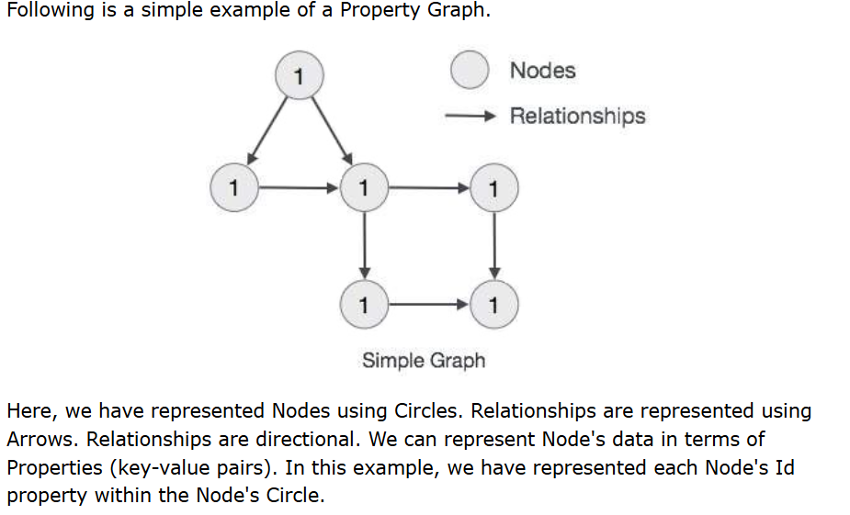

Slide 14
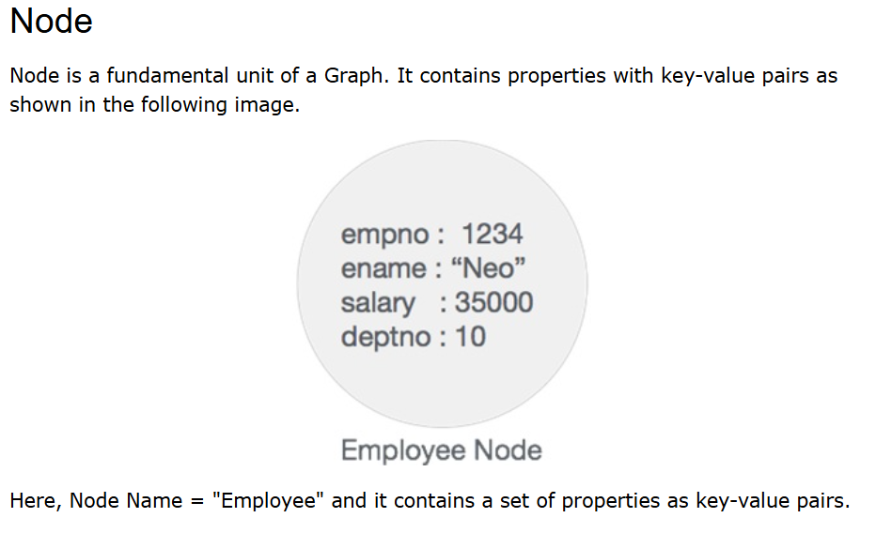

Slide 15
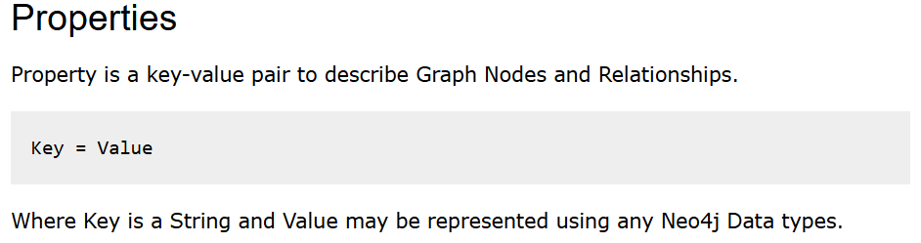

Slide 16
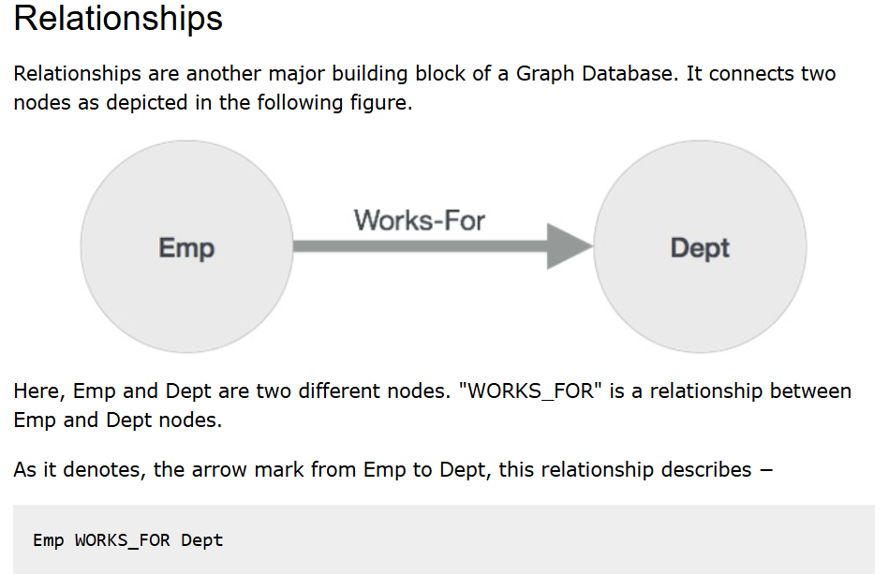

Slide 17
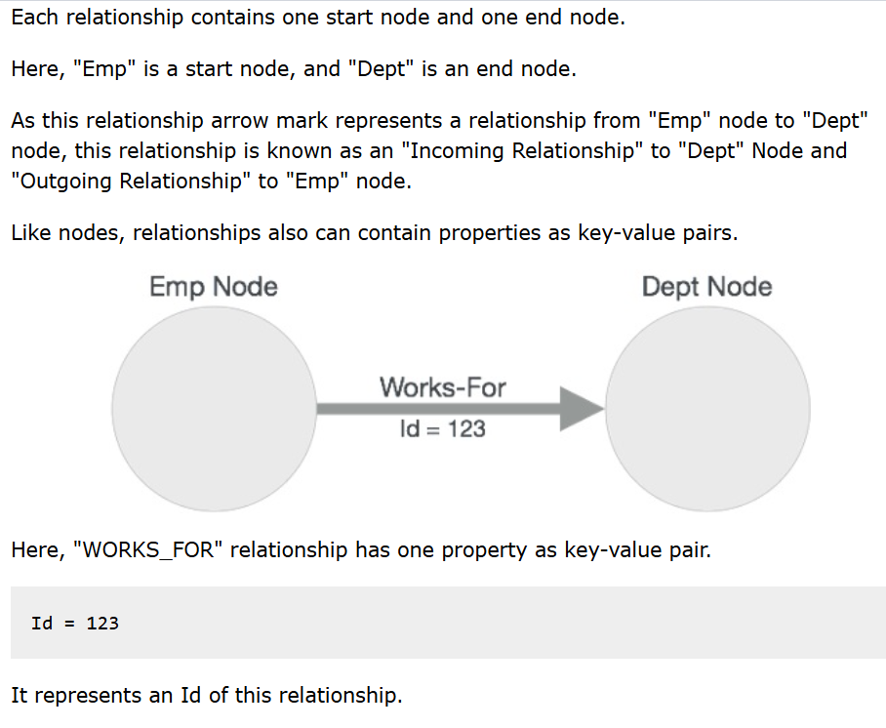

Slide 18
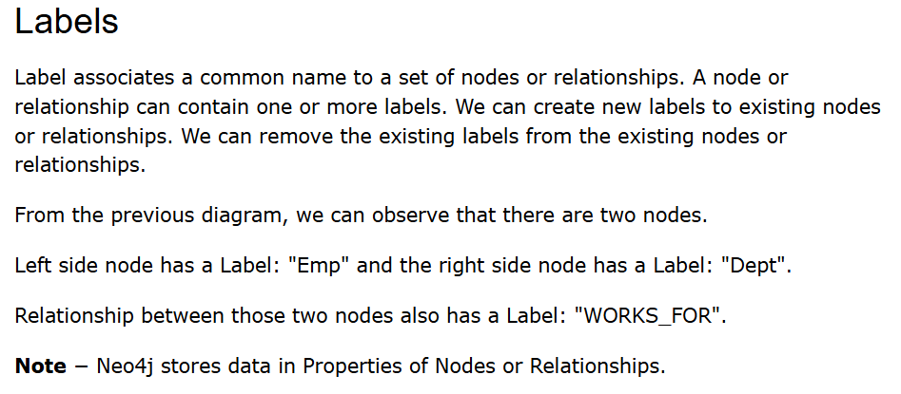

Slide 19
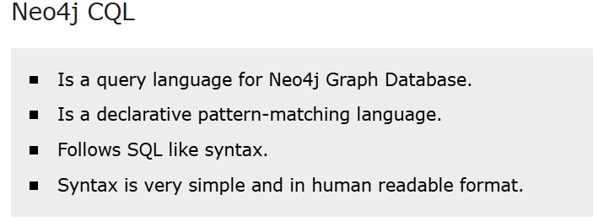
CQL stands for Cypher Query Language. Like Oracle Database has query language SQL, Neo4j has CQL as query language.

Slide 20
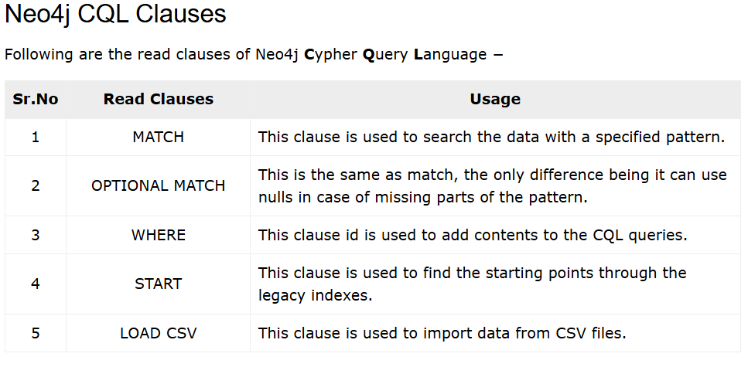

Slide 21
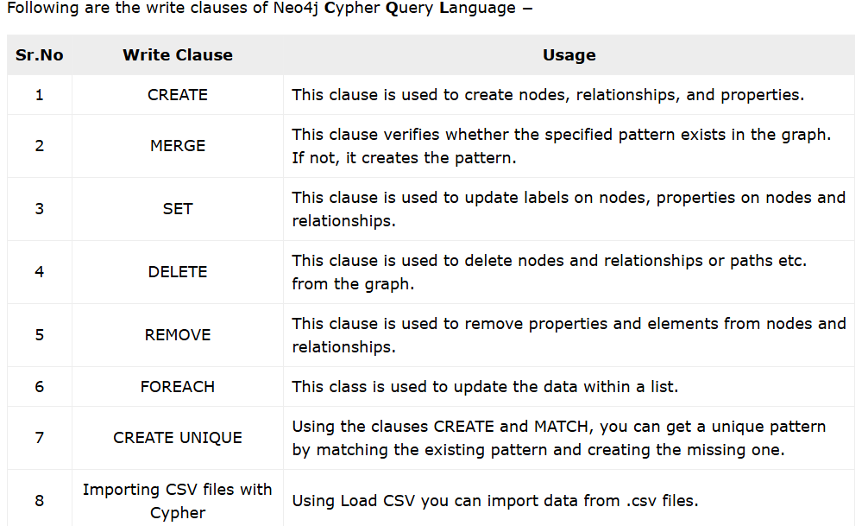

Slide 22
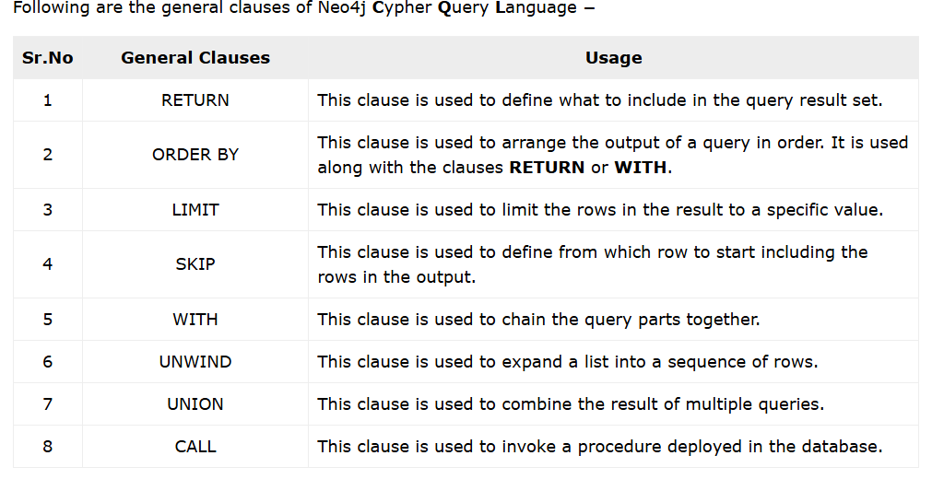

Slide 23
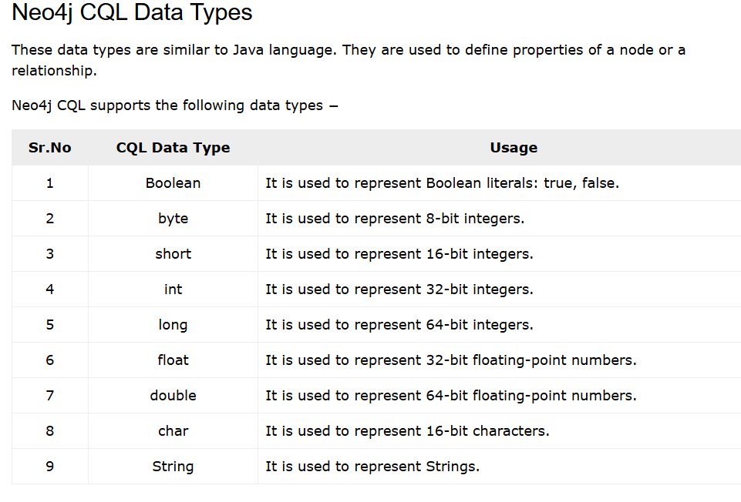

Slide 24
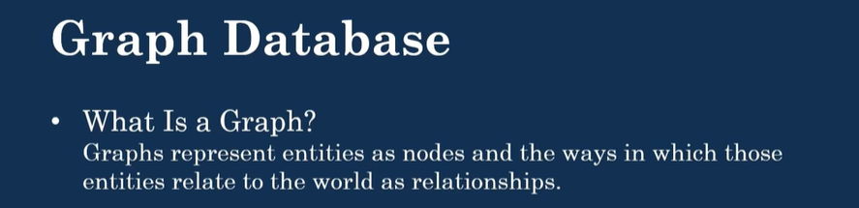
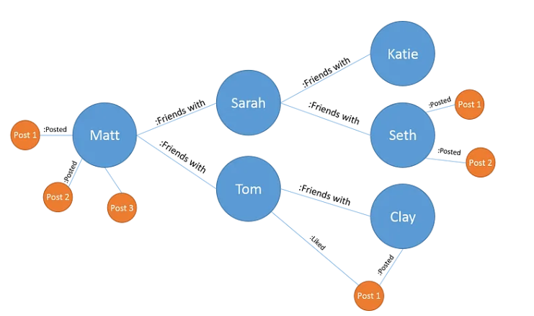

Slide 25
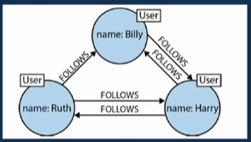
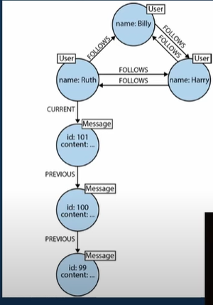
All the details provided, ex. Name, phone no, email id, location are represented as nodes.
This creates billions of nodes.
Graph database looks like above
“Walking the graph” means:
Moving from one node to another through relationships

Slide 26
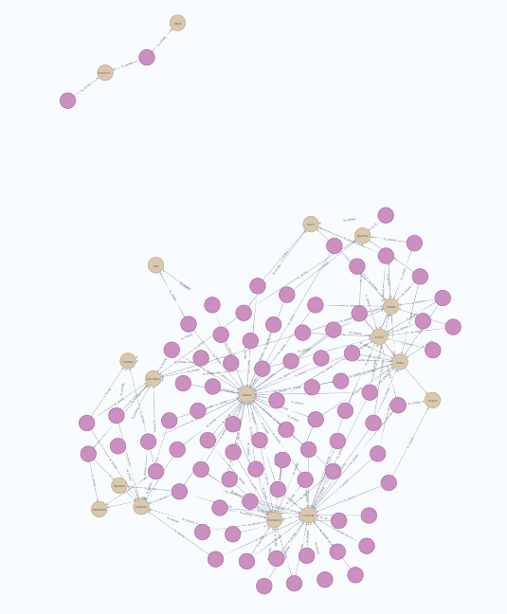
To see all nodes in a relationship
Neo4j$ MATCH (n) RETURN n LIMIT 100

Slide 27
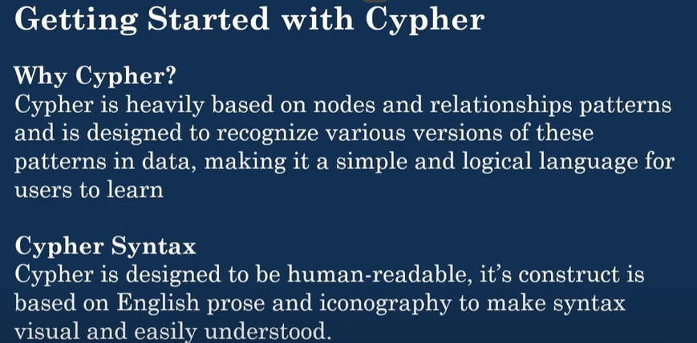

Slide 28
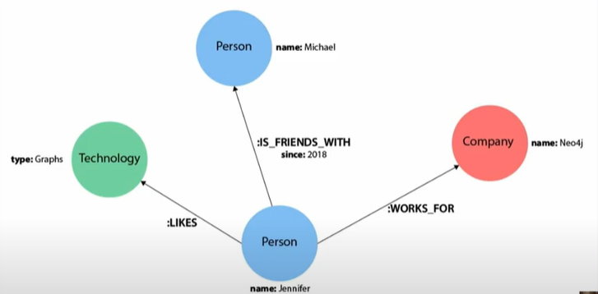
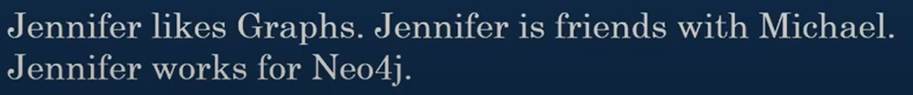

Slide 29
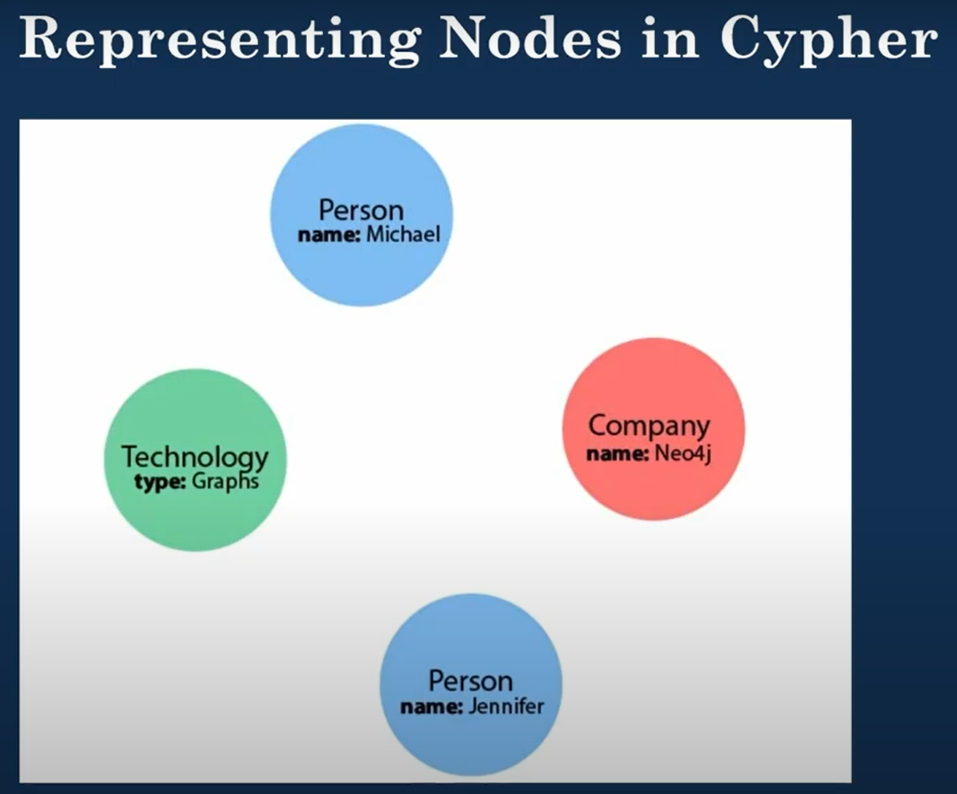
Nodes represent the data entity in the graph.
The graph contains with four nodes.
To depict nodes in Cypher, we surround the node with parentheses.
Ex. (node)

Slide 30
Two key concepts in the property graph data model:
Node Variables: These are placeholders used to refer to nodes later in queries.Example: (p) could stand for a person, (t) for a thing.
Node Labels: These are used to group similar nodes by type. Labels act like tags (e.g., :Person, :Book) and help filter or create specific types of entities in a graph database.

Slide 31
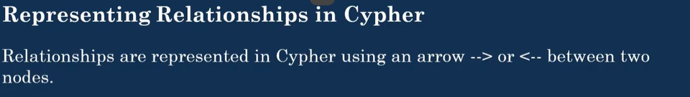
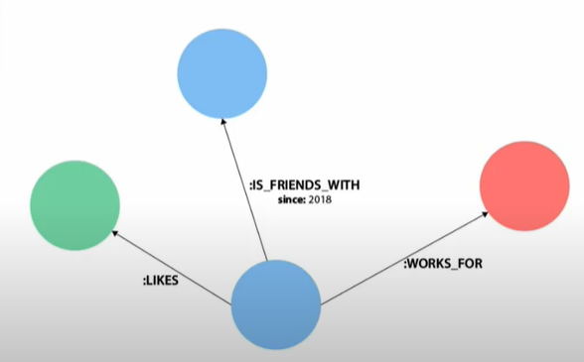

Slide 32
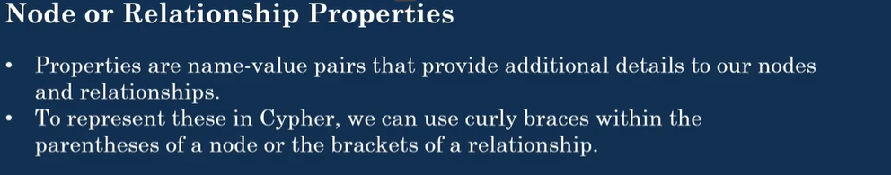

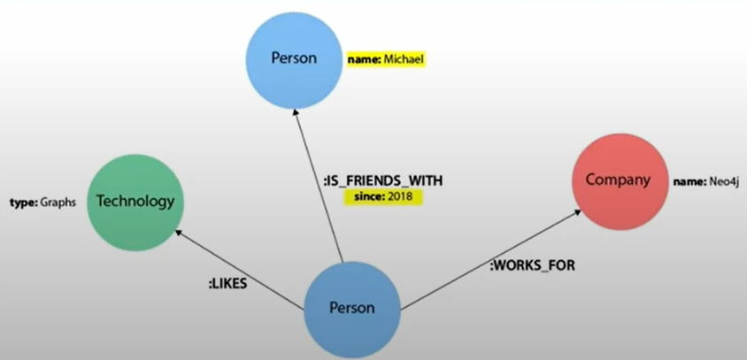

Slide 33
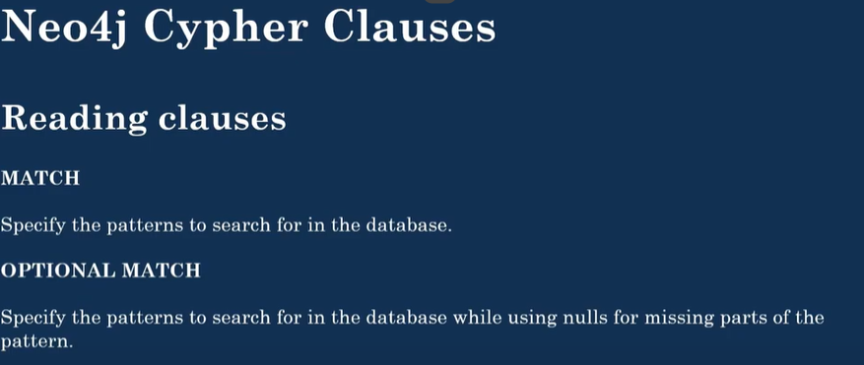

Slide 35
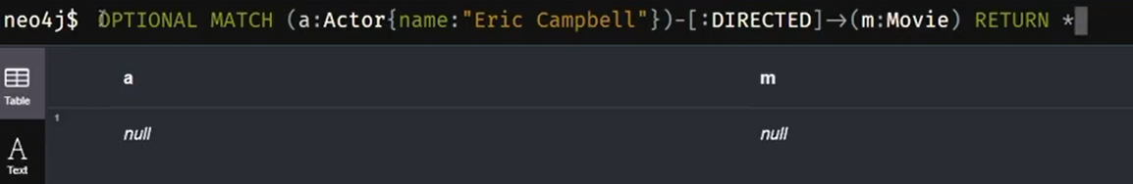

Slide 36
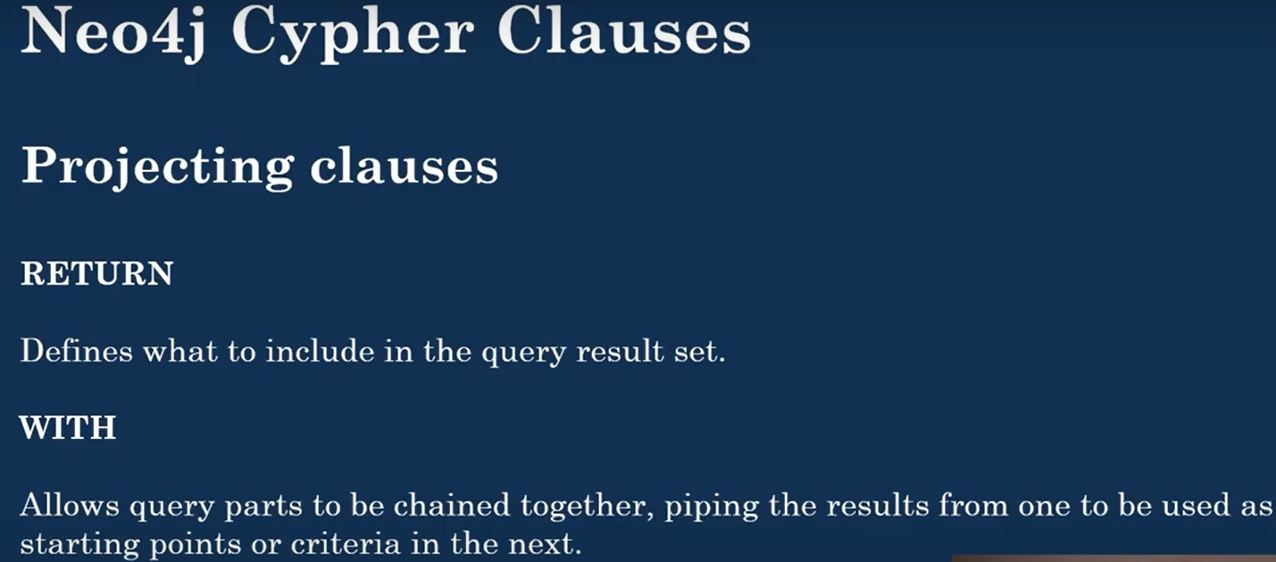
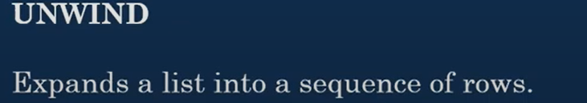

Slide 37
